Slide 1
Painterly Rendering
SeungJun Lee

Slide 2
Related Work
Painterly Rendering with Curved Brush Strokes of Multiple Sizes
By Aaron Hertzmann

Slide 3
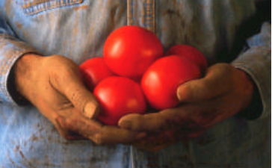
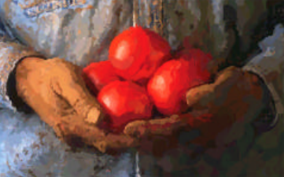
Painterly Rendering from the Paper
532 x 335
Original
Rendered

Slide 4
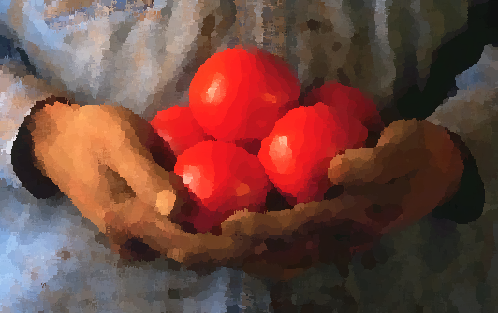
Opencv Oilpainting function
Original
Rendered

Slide 5

Painterly Rendering Algorithm

Slide 6
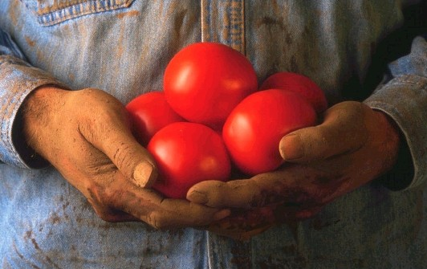

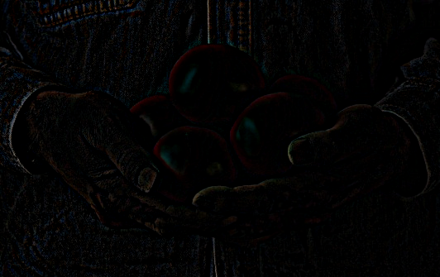
Painterly Rendering Algorithm
-
=

Slide 7
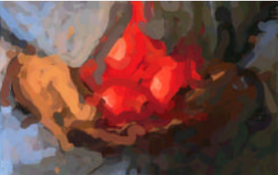
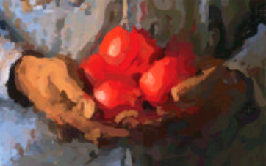
Painterly Rendering Algorithm

Slide 8
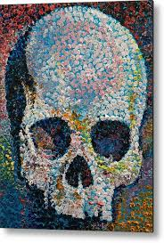
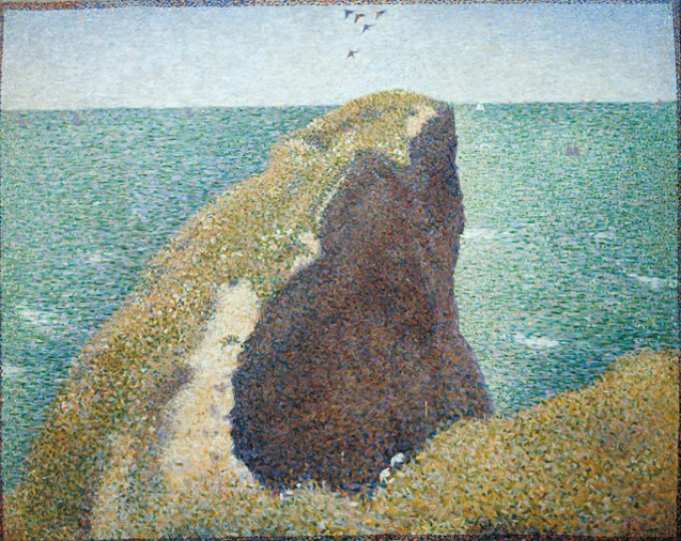
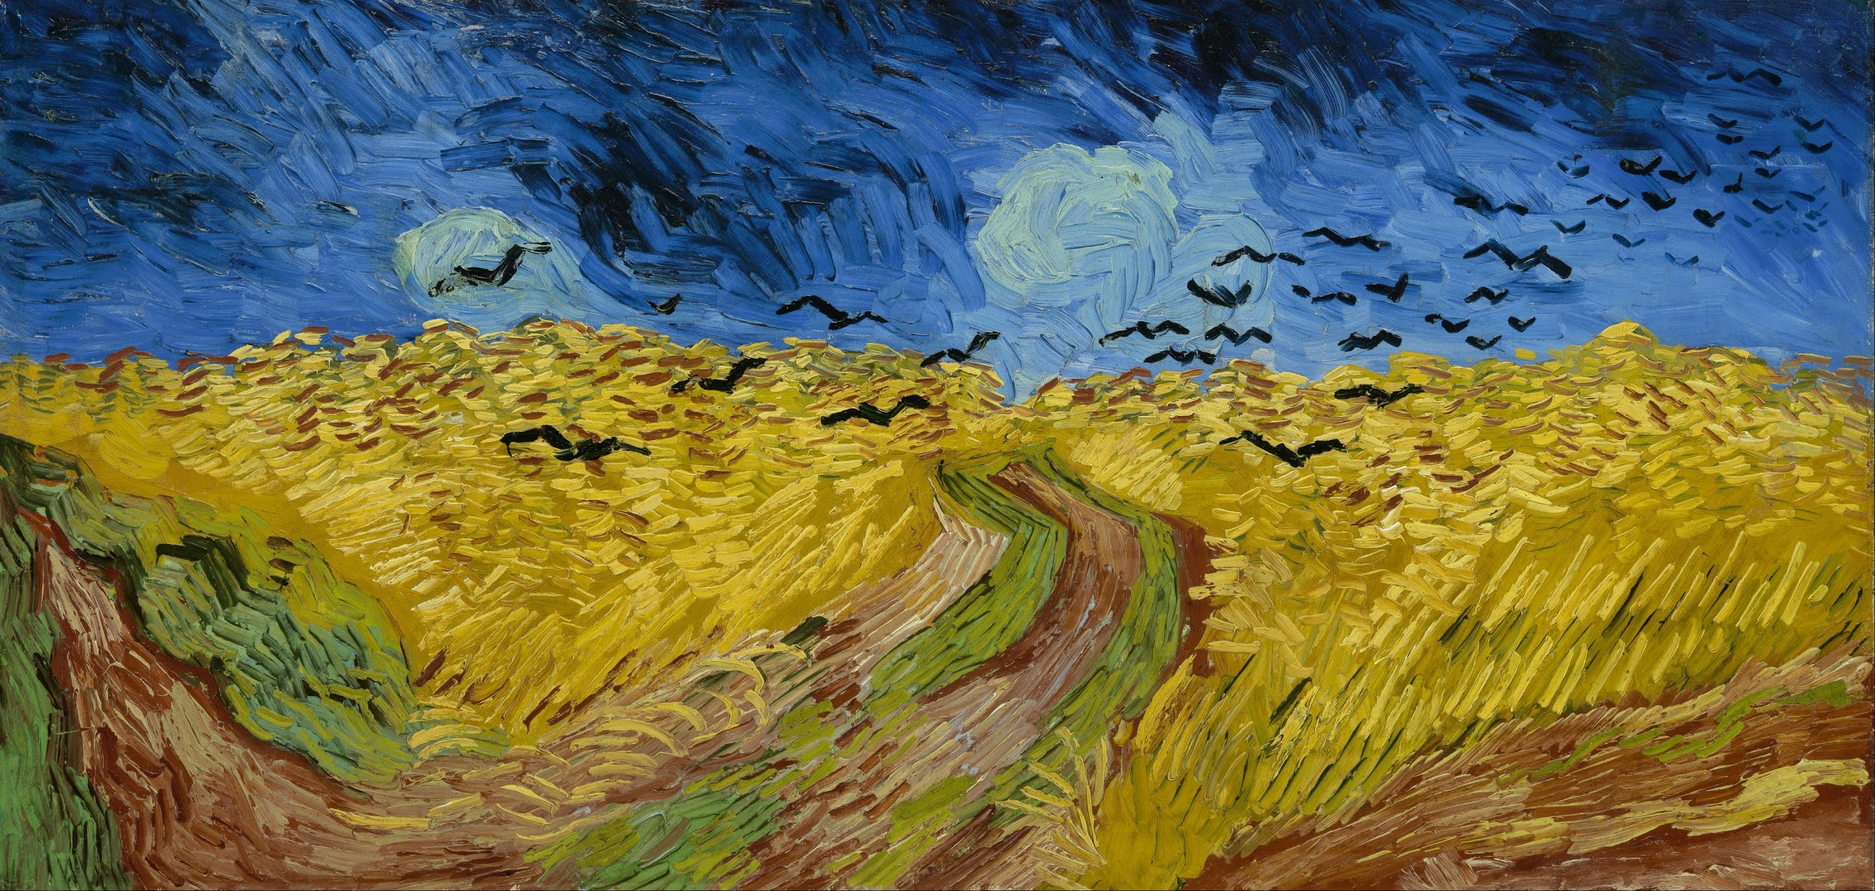
My Approach

Slide 9
Implementation Approach
Create Brush size queue
For each Brush size create Gaussian blurred image (reference)
Create difference map of Original and Reference
Traverse the difference map with brush size and if the RGB value is above a limit, draw that x-y coordinate onto canvas with reference’s x-y coordinate color
Rinse and repeat throughout all the brush size. Largest to smallest.

Slide 10
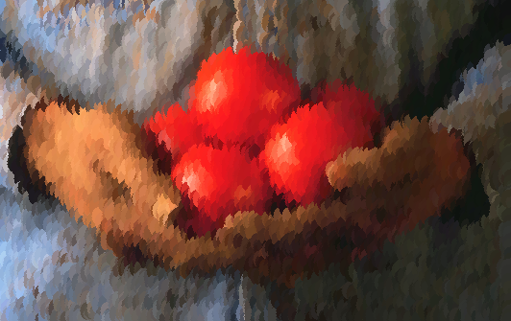
Result: Example
Paper
Oilpainting
Implementation

Slide 11
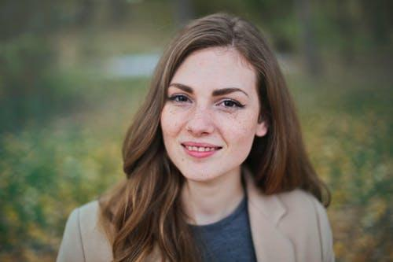
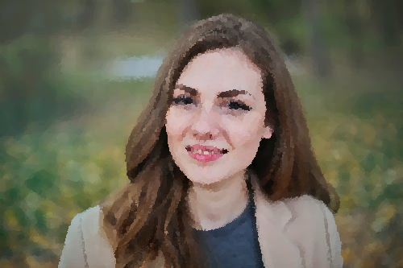
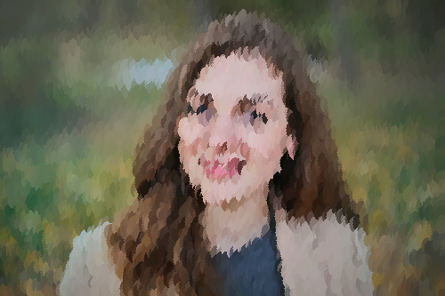
Results: Real Portraits
500 x 333

Slide 12
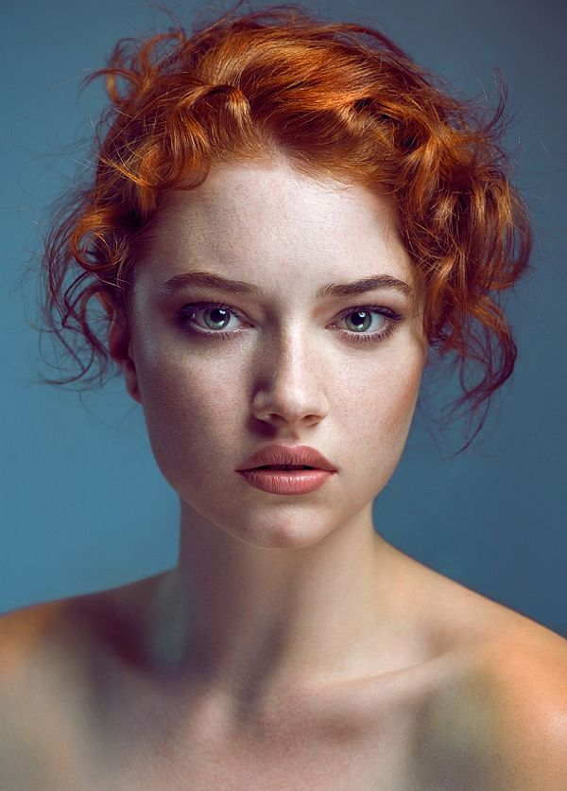
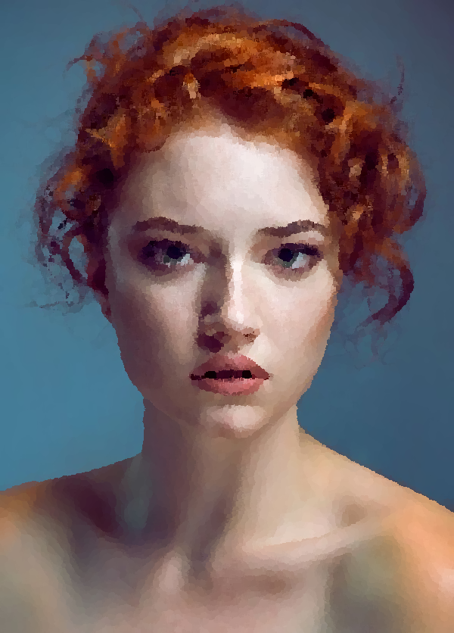
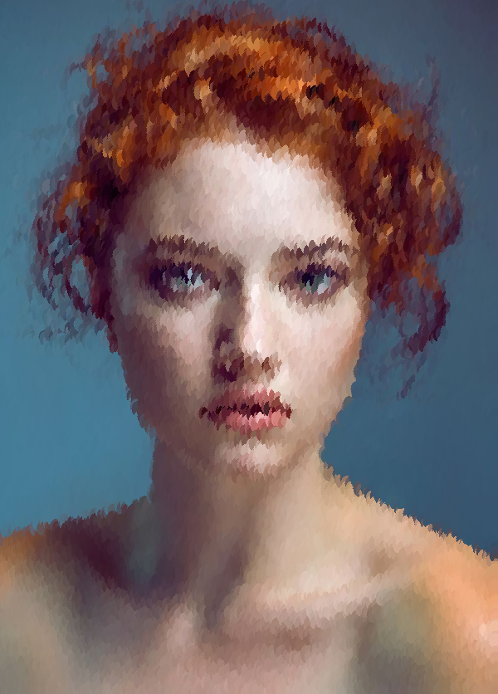
Results: Real Portraits
600 x 836

Slide 13
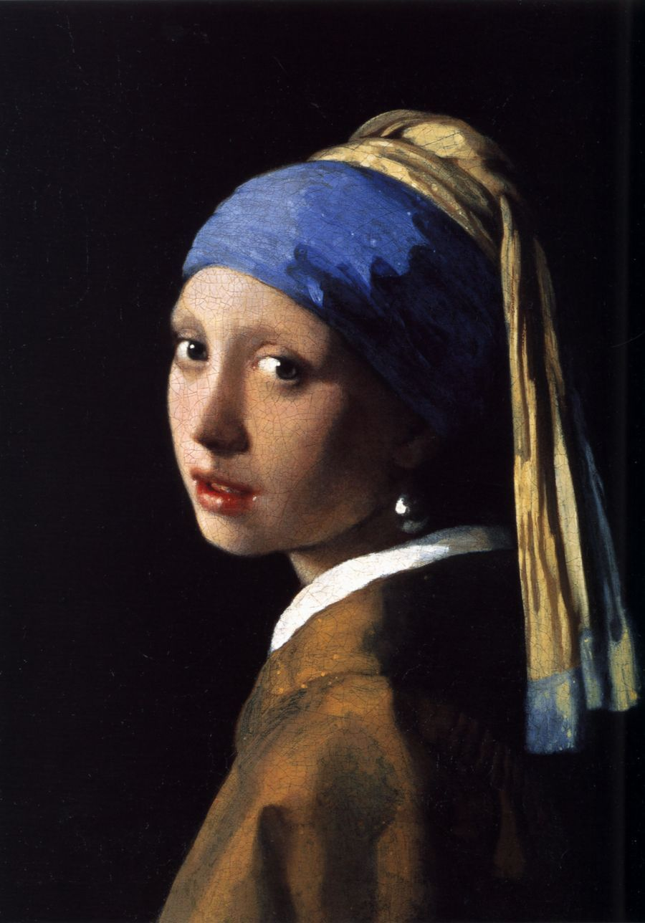
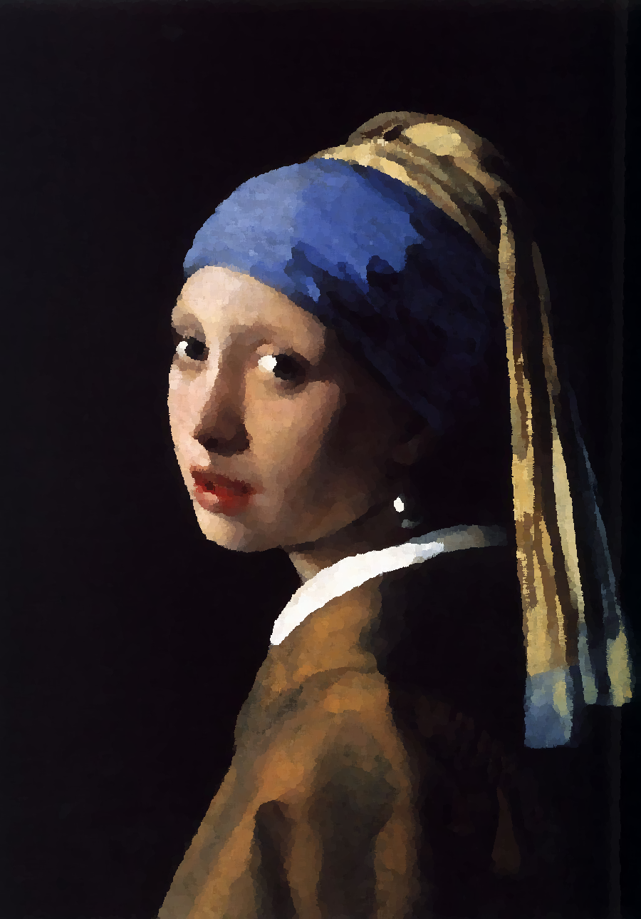

Result: Painterly of Paintings
900 x 1288

Slide 14
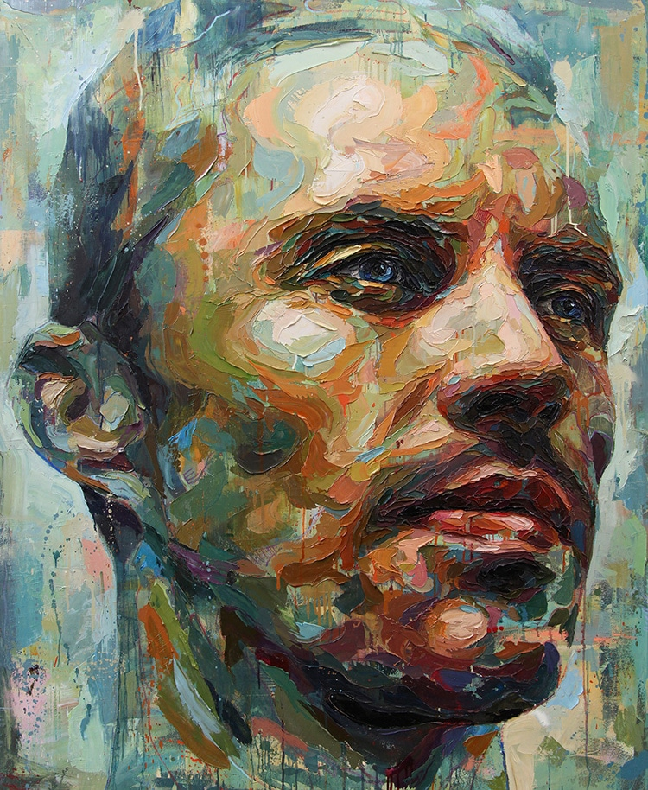
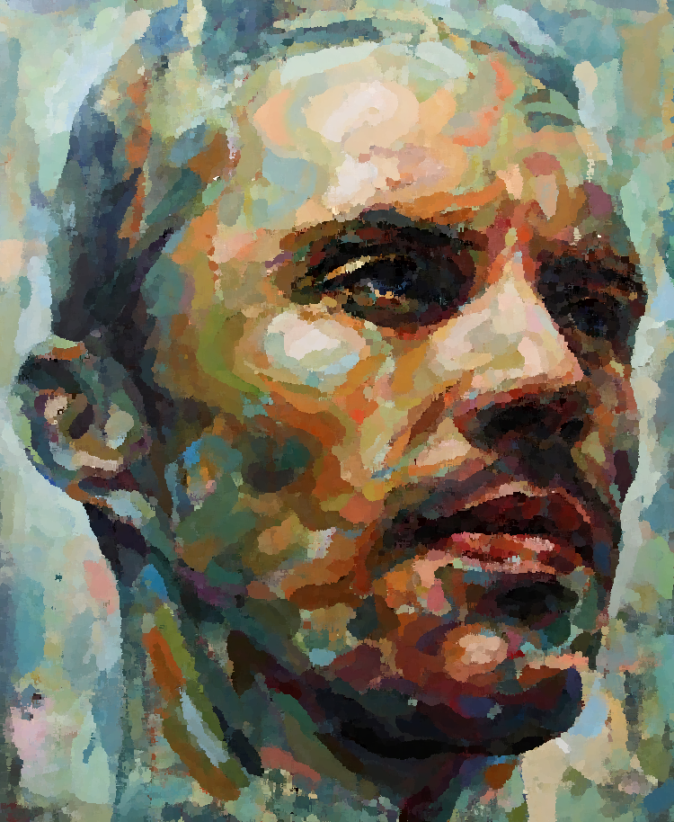
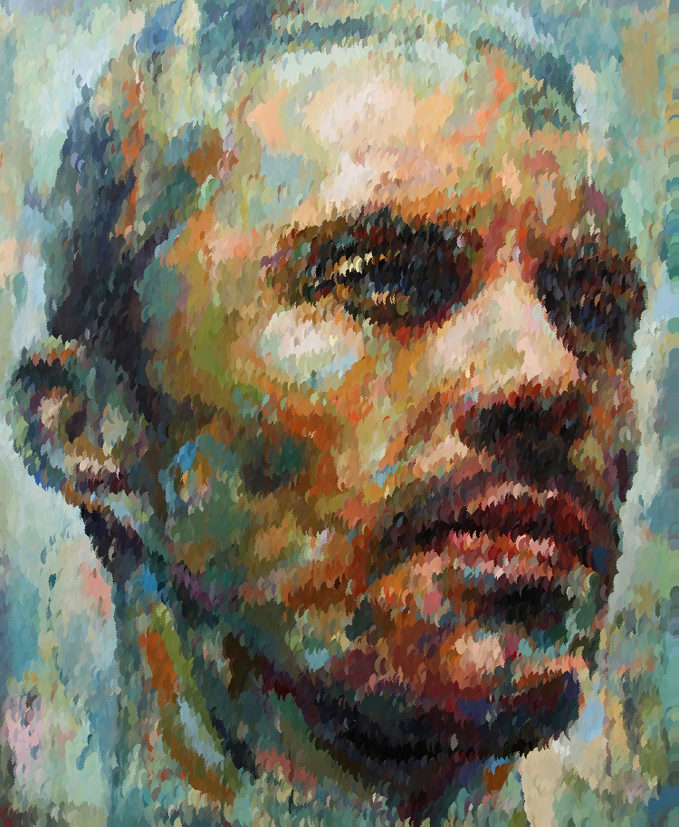
Result: Painterly of Paintings
750 x 914

Slide 15
Things to Improve
Brush size and iteration calculation
Difference detection
Detail focusing
Random brush stroke implementation

Slide 16
Questions?

Slide 17
Thank you

